Slide 1
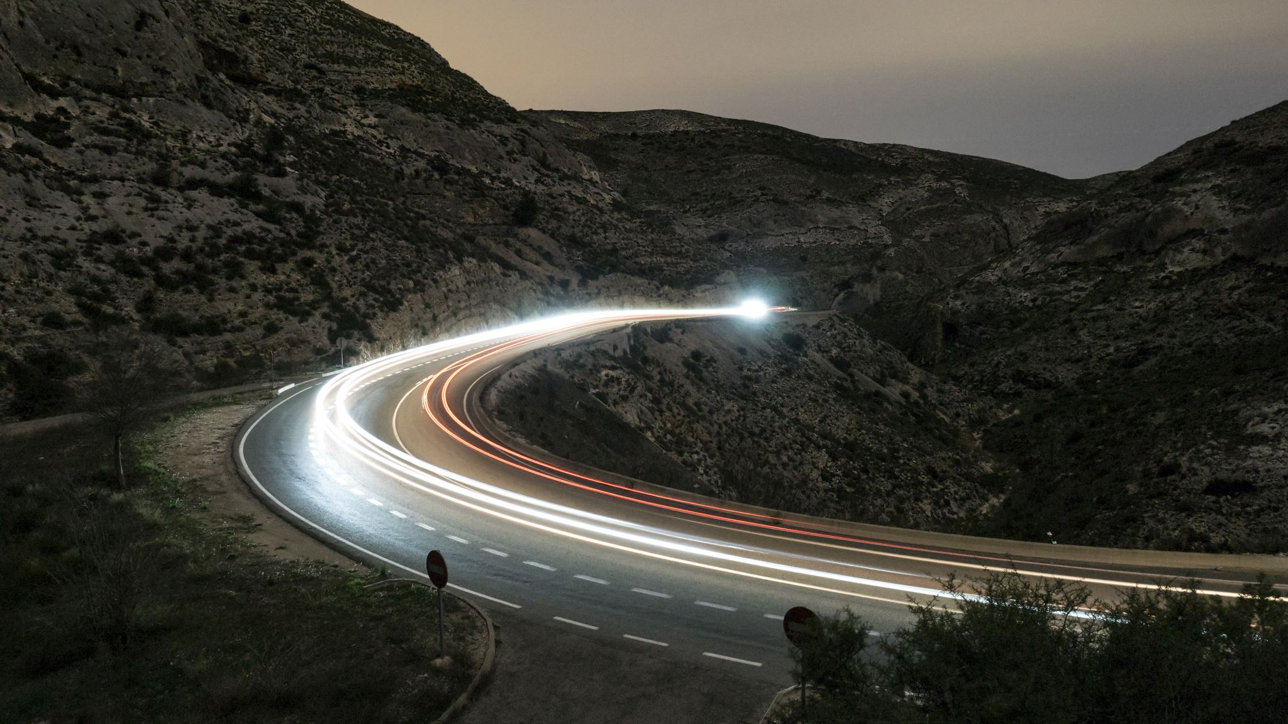
Driver Drowsiness Detection
Heet Soni 100768241
Jack Lemere 100591906
Shrita Gaonkar 100799307

Slide 2
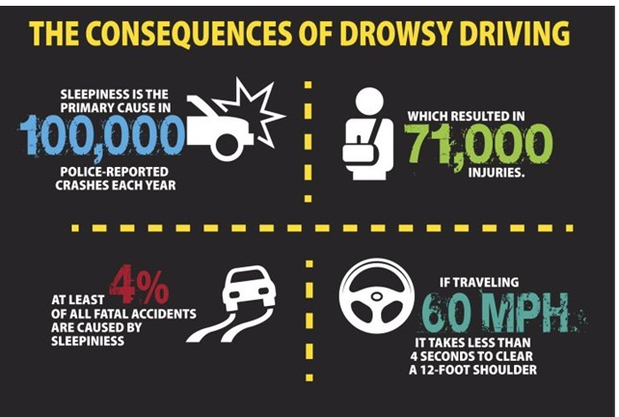
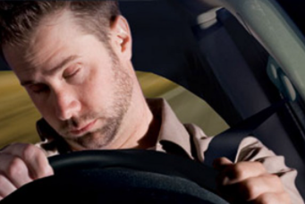
Abstract
Statistics on drowsy driving-related incidents and injuries
Sleeping and driving are a fatal combo.

Slide 3
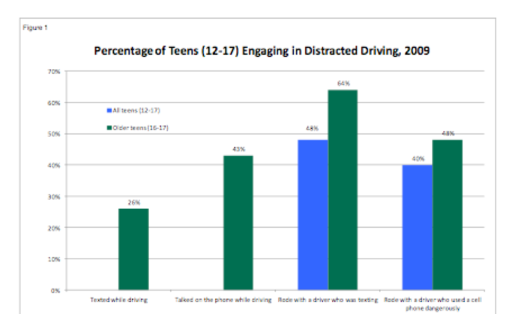
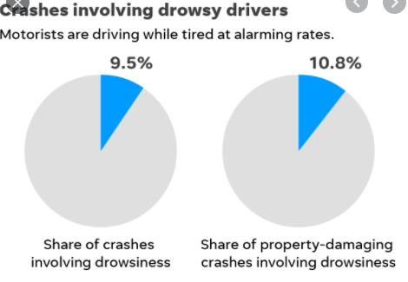
Accidents caused in teens due to drowsiness while driving
Statistically, academic pressure, early school times, are amongst many reasons why young drivers are tired.
According to NSF’s 2006 Sleep in America poll, more than half of teens drove drowsy in the past year.
15% of drivers in 10th to 12th grades state they drove drowsy at least once a week.

Slide 4
Objectives
The majority of accidents happen due to the drowsiness of the driver.
So, to prevent these accidents we will build deep learning classification model using Python, CNN and Keras, which will predict whether the driver has sleepy eyes or not.
The objective of our project is to detect drowsiness in drivers to avoid lower the percentage of injuries and accidents caused by drowsiness.

Slide 5
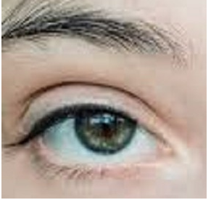

Dataset
For this project, We have downloaded the dataset from Kaggle.
The dataset has 726 images of open and closed human eye respectively.
We also had to download an XML data file for getting the labels on the image.

Slide 6
Time plan of project activities and deliverables
Task | Hours | Delivery date | Responsibility taken by
Collecting the dataset | 4 | March 8, 2021 | Heet
Analyze and clean the dataset | 30 | March 18, 2021 | Heet
Train the model | 31 | March 23, 2021 | Jack
Test and evaluate the model | 9 | March 23, 2021 | Jack
Create flask app and GUI | 30 | March 29, 2021 | Shrita
Deploy the model on Heroku | 9 | April 1, 2021 | Shrita
Creating the final report and presentation video | 5 | April 3, 2021 | Heet 29

